Slide 1
Basic Crystal Structures and Free Electron Model in Applied Physics
University Physics Presentation
Presented by: [anchal , samapati , shiyooti]

Slide 2
Introduction
• In solids, atoms are arranged in a specific order.
• This order affects how materials behave: their strength, conductivity, etc.
• Today, we’ll look at two important physics concepts:
- Crystal structures
- Free electron model

Slide 3
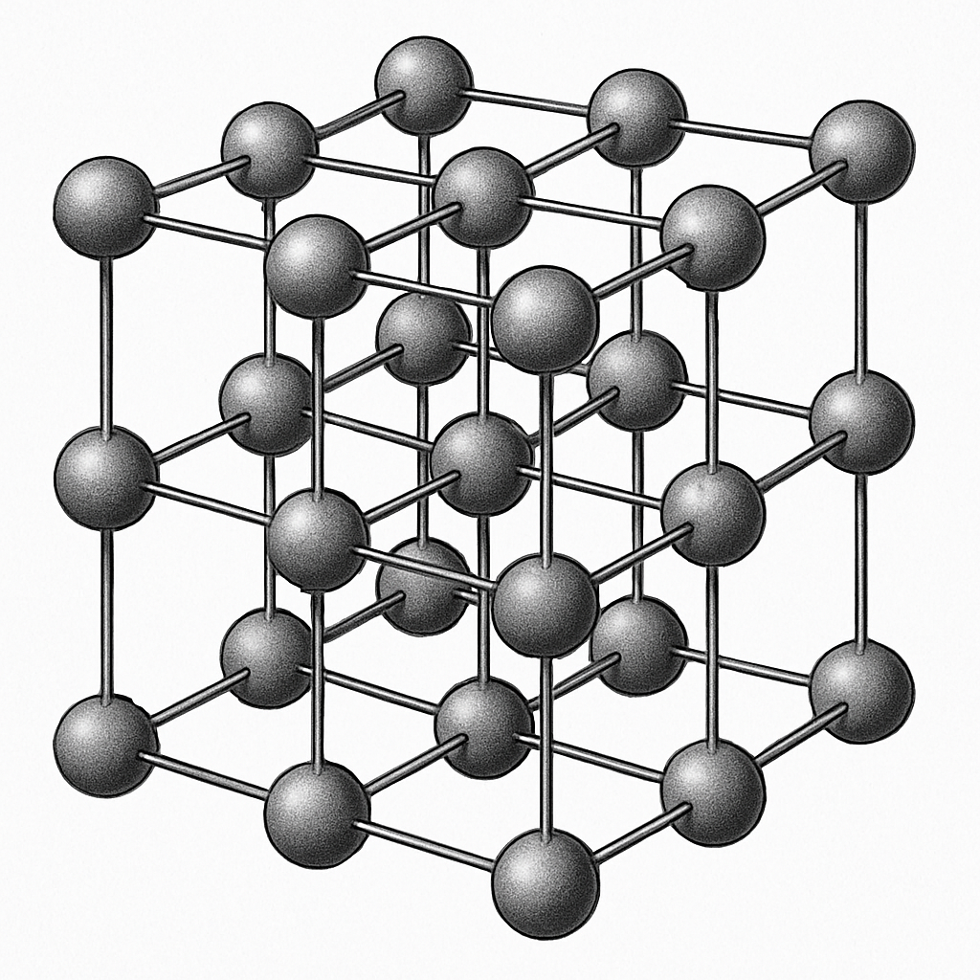
What is a Crystal Structure?
• Crystals have atoms arranged in a repeating 3D pattern.
• These repeating units are called lattices.
• A basis is a group of atoms placed on each lattice point.
• This combination forms a crystal structure.

Slide 4
Unit Cell and Parameters
• Unit Cell: Smallest repeating unit of a crystal.
• The unit cell repeats to form the full structure.

Slide 5
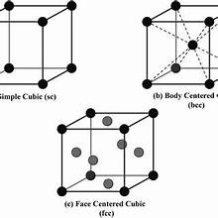
Common Crystal Structures
• Simple Cubic (SC): Atoms at corners only. Loose packing.
• Body-Centered Cubic (BCC): Atoms at corners + center. Moderate packing.
• Face-Centered Cubic (FCC): Atoms at corners + faces. Tight packing.

Slide 6
Crystal Structures in Real Materials
• Examples:
- Iron: BCC (room temp), FCC (high temp)
- Aluminum: FCC
- Titanium: HCP
• Structure affects strength, conductivity, and melting point.

Slide 7
Types of Crystal Systems
• 7 types of crystal systems:
- Cubic
- Tetragonal
- Orthorhombic
- Monoclinic
- Triclinic
- Hexagonal
- Rhombohedral
• Each has unique angles and edge lengths.

Slide 8
What is the Free Electron Model?
• how electrons move in metals.
• Electrons behave like free-moving particles (electron gas).
• They don’t stick to atoms and can travel through the material.

Slide 9
Assumptions of the Model
• Electrons are free and don’t interact with irons.
• Constant potential/voltage inside the metal.
• Electrons obey quantum laws (Fermi-Dirac statistics).
• They fill up energy levels up to the Fermi energy.

Slide 10
Predictions of the Free Electron Model
- Good electrical and thermal conductivity
- Linear relation between heat and electricity (Wiedemann-Franz law)
- Heat capacity at low temperatures

Slide 11
Limitations of the Model
- Insulators and semiconductors
- Band gaps and resistivity
- Electron interaction with periodic atomic potential
Mathmetically: V(r)=V(r+R)

Slide 12
Advanced Models
• Band Theory: Shows energy bands and gaps.
• Explains why some materials are conductors, others insulators or semiconductors.

Slide 13
Applications in Technology
• Crystal structures help in designing:
- Stronger metals
- Better semiconductors
• Free electron model is used in:
- Electrical and thermal design
- Nanomaterials and electronic devices

Slide 14
Conclusion
• Crystal structures define how atoms are arranged.
• Free electron model explains movement of electrons in metals.
• Together, they help us understand material behavior in engineering and physics.

Slide 15
THANKYOU

